Slide 1
Japan TC Chapter
Information & Control
Global Technical Committee
Liaison Report
August 21, 2024

Slide 2
Meeting Information
Last meeting
  Friday July 26th, 2024, 11:00-14:30 [JST]
  SEMI Japan Office + OVTCCM [Hybrid]
Next meeting
  Friday December 21st, 2024, 13:30-16:30 [JST]
  International Conference Hall, SEMICON Japan 2024 + OVTCCM [Hybrid]
http://www.semi.org/en/standards-events

Slide 3
Leadership Changes
Yuko Toyoshima / Hitachi High-Tech Corporation was recommended as the third I&C co-chair and she agreed.
  Next Action: To bring this recommendation, a new I&C Co-chair, to next JRSC Meeting.

Slide 4
Committee Structure Changes
Sensor Bus Task Force [Disbanded]

Slide 5
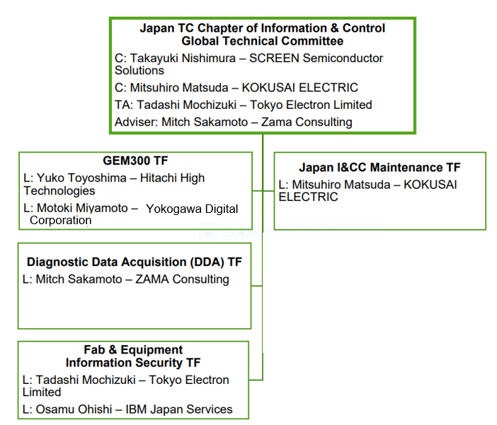
Organization Chart

Slide 6
Ballot Results
Doc# | Document Title | TC Chapter Action​7
7173 | Line-Item Revision to SEMI E30-0423, SPECIFICATION FOR THE GENERIC MODEL FOR COMMUNICATIONS AND CONTROL OF MANUFACTURING EQUIPMENT (GEM) Ratification ballot will be issued for Cycle 7
Line Item 1 | Remove requirements to the host. | Passed as balloted
Line Item 2 | Corrections in scenarios in section 7.2 and 7.3. | Passed TC Chapter review with editorial changes
Line Item 3 | Corrections in section 7.7 Process Program Management | Passed with Technical Changes, Ratification Ballot to be issued.
Line Item 4 | Corrections in section 7.14 documentation request. | Passed with Technical Changes, Ratification Ballot to be issued.
Line Item 5 | Corrections in Appendixes | Passed as balloted
Note 1: Passed ballots and line items will be submitted to the ISC Audit & Review Subcommittee for procedural review.​
​Note 2: Failed ballots and line items were returned to the originating task forces for re-work and re-balloting or abandoning. ​
Notes:
Correct terms to be used in “TC Chapter Action” column (shall match the CER)
Note: Use green font color for “Passed” and red for “Failed”
Passed, as balloted
Passed, with editorial changes
Passed, Ratification Ballot to be issued
Failed
Also include when applicable:
Ratification Ballots – In the “TC Chapter Action” column, state either passed and what cycle or failed: Example: “Passed, A&R Cycle 9-2017”
Other activities outside the Letter Ballot process – In the “Doc #” column, put the SEMI Standard Designation # – In the “Doc Title” column, put the full SEMI Standard title and underneath in parenthesis, briefly state what was done (Example: Delete “NOTE 2…” after section 3.1) – In the “TC Chapter Action” column, state either “Passed, submitted to ISC A&R SC” or “Fail”

Slide 7
Activities Approved via GCS between Meetings
None
# | Type | SC/TF/WG | Title/Details
None

Slide 8
Authorized Activities
# | Type | SC/TF/WG | Document Title/Details
None
#1: SNARFs and TFOFs are available for review on the SEMI Web site at:
http://downloads.semi.org/web/wstdsbal.nsf/TFOFSNARF
Notes:
Correct terms to be used in “TC Chapter Action” column (shall match the CER)
Note: Use green font color for “Passed” and red for “Failed”
Passed, as balloted
Passed, with editorial changes
Passed, Ratification Ballot to be issued
Failed
Also include when applicable:
Ratification Ballots – In the “TC Chapter Action” column, state either passed and what cycle or failed: Example: “Passed, A&R Cycle 9-2017”
Other activities outside the Letter Ballot process – In the “Doc #” column, put the SEMI Standard Designation # – In the “Doc Title” column, put the full SEMI Standard title and underneath in parenthesis, briefly state what was done (Example: Delete “NOTE 2…” after section 3.1) – In the “TC Chapter Action” column, state either “Passed, submitted to ISC A&R SC” or “Fail”

Slide 9
Other Activities Outside the Letter Ballot Process
# | Type | SC/TF/WG | Details
None
Notes:
Correct terms to be used in “TC Chapter Action” column (shall match the CER)
Note: Use green font color for “Passed” and red for “Failed”
Passed, as balloted
Passed, with editorial changes
Passed, Ratification Ballot to be issued
Failed
Also include when applicable:
Ratification Ballots – In the “TC Chapter Action” column, state either passed and what cycle or failed: Example: “Passed, A&R Cycle 9-2017”
Other activities outside the Letter Ballot process – In the “Doc #” column, put the SEMI Standard Designation # – In the “Doc Title” column, put the full SEMI Standard title and underneath in parenthesis, briefly state what was done (Example: Delete “NOTE 2…” after section 3.1) – In the “TC Chapter Action” column, state either “Passed, submitted to ISC A&R SC” or “Fail”

Slide 10
Authorized Ballots
# | Type | SC/TF/WG | Details
7005 | Cycle 7 and 8, 2024 | JA I&C Maintenance Task Force | Line-Item Revision to SEMI E91-1217: SPECIFICATION FOR PROBER SPECIFIC EQUIPMENT MODEL (PSEM) Ballot Submission on.
Notes:
Correct terms to be used in “TC Chapter Action” column (shall match the CER)
Note: Use green font color for “Passed” and red for “Failed”
Passed, as balloted
Passed, with editorial changes
Passed, Ratification Ballot to be issued
Failed
Also include when applicable:
Ratification Ballots – In the “TC Chapter Action” column, state either passed and what cycle or failed: Example: “Passed, A&R Cycle 9-2017”
Other activities outside the Letter Ballot process – In the “Doc #” column, put the SEMI Standard Designation # – In the “Doc Title” column, put the full SEMI Standard title and underneath in parenthesis, briefly state what was done (Example: Delete “NOTE 2…” after section 3.1) – In the “TC Chapter Action” column, state either “Passed, submitted to ISC A&R SC” or “Fail”

Slide 11
Task Force Highlights​
Japan I&C Maintenance Task Force Report
  Draft Document 7005 Line Item Revision to SEMI E91-1217: SPECIFICATION FOR PROBER SPECIFIC EQUIPMENT MODEL (PSEM)
    Under development
GEM300 Task Force Meeting
  E30-0423 Consideration of Correction

Slide 12
Other Topics​
The SEMI SECS GEM / GEM300 tutorial is available via SEMI University at
  Web on-demand seminar in Japanese
    https://store-jp.semi.org/products/semi-software-standard-gem300-seminar-japanese-only-semi-%E3%82%BD%E3%83%95%E3%83%88%E3%82%A6%E3%82%A8%E3%82%A2%E3%82%B9%E3%82%BF%E3%83%B3%E3%83%80%E3%83%BC%E3%83%89gem300%E3%82%BB%E3%83%9F%E3%83%8A%E3%83%BC
    https://store-jp.semi.org/products/semi-software-standard-secs-gem-seminar-japanese-only-semi-%E3%82%BD%E3%83%95%E3%83%88%E3%82%A6%E3%82%A8%E3%82%A2%E3%82%B9%E3%82%BF%E3%83%B3%E3%83%80%E3%83%BC%E3%83%89-secs-gem%E3%82%BB%E3%83%9F%E3%83%8A%E3%83%BC

Slide 13
Open SNARF
# | SC/TF/CFG | Title/Details
7173 | GEM 300 TF | Line-Item Revision to SEMI E30-0423, SPECIFICATION FOR THE GENERIC MODEL FOR COMMUNICATIONS AND CONTROL OF MANUFACTURING EQUIPMENT (GEM)
7005 | JA I&C Maintenance Task Force | Line Item Revision to SEMI E91-1217: SPECIFICATION FOR PROBER SPECIFIC EQUIPMENT MODEL (PSEM)
Notes:
Correct terms to be used in “TC Chapter Action” column (shall match the CER)
Note: Use green font color for “Passed” and red for “Failed”
Passed, as balloted
Passed, with editorial changes
Passed, Ratification Ballot to be issued
Failed
Also include when applicable:
Ratification Ballots – In the “TC Chapter Action” column, state either passed and what cycle or failed: Example: “Passed, A&R Cycle 9-2017”
Other activities outside the Letter Ballot process – In the “Doc #” column, put the SEMI Standard Designation # – In the “Doc Title” column, put the full SEMI Standard title and underneath in parenthesis, briefly state what was done (Example: Delete “NOTE 2…” after section 3.1) – In the “TC Chapter Action” column, state either “Passed, submitted to ISC A&R SC” or “Fail”

Slide 14
SNARF(s) Abolished
# | SC/TF/CFG | Title/Details
None
Notes:
Correct terms to be used in “TC Chapter Action” column (shall match the CER)
Note: Use green font color for “Passed” and red for “Failed”
Passed, as balloted
Passed, with editorial changes
Passed, Ratification Ballot to be issued
Failed
Also include when applicable:
Ratification Ballots – In the “TC Chapter Action” column, state either passed and what cycle or failed: Example: “Passed, A&R Cycle 9-2017”
Other activities outside the Letter Ballot process – In the “Doc #” column, put the SEMI Standard Designation # – In the “Doc Title” column, put the full SEMI Standard title and underneath in parenthesis, briefly state what was done (Example: Delete “NOTE 2…” after section 3.1) – In the “TC Chapter Action” column, state either “Passed, submitted to ISC A&R SC” or “Fail”

Slide 15
Five-Year Review
Destination | Standard Title | Action By | Assigned to
None
Notes:
Correct terms to be used in “TC Chapter Action” column (shall match the CER)
Note: Use green font color for “Passed” and red for “Failed”
Passed, as balloted
Passed, with editorial changes
Passed, Ratification Ballot to be issued
Failed
Also include when applicable:
Ratification Ballots – In the “TC Chapter Action” column, state either passed and what cycle or failed: Example: “Passed, A&R Cycle 9-2017”
Other activities outside the Letter Ballot process – In the “Doc #” column, put the SEMI Standard Designation # – In the “Doc Title” column, put the full SEMI Standard title and underneath in parenthesis, briefly state what was done (Example: Delete “NOTE 2…” after section 3.1) – In the “TC Chapter Action” column, state either “Passed, submitted to ISC A&R SC” or “Fail”

Slide 16
Question?
For more information, please contact
Hirofumi Kanno at hkanno@semi.org

